Slide 1
WORLDWIDE COVID-19 VACCINATION RACE
BSAN 460 – Team 4 – Final Presentation
Notes:
Assima

Slide 2
Agenda
01.
02.
03.
04.
INTRODUCTION
MARKET RESEARCH
Our Team and
Project Summary
Background Information and Issue Tree
DATA ANALYSIS
CONCLUSION
Data Models and Results
Key Findings,
Business Insights & Recommendations
Notes:
Assima

Slide 3
01.
INTRODUCTION
Notes:
Assima

Slide 4





OUR TEAM
ASSIMA IMATALIYEVA
TAY PHAN
JUSTIN NGUYEN
ARI WEISS
ADAM YOUSIF
Team Leader
Data Analyst
Data Analyst
Data Analyst
Research Reporter
Senior majoring in Finance & Business Analytics
International student from Kazakhstan
Graduating Senior majoring in Marketing & Business Analytics
International student from Vietnam
Senior in Marketing, Business Analytics, & Business Economics
From San Jose, CA
Graduating Senior in Accounting & Business Analytics
From Cherry Hill, New Jersey
Graduating Senior majoring in MIS & Business Analytics
From Burlington, New Jersey
Notes:
Assima

Slide 5
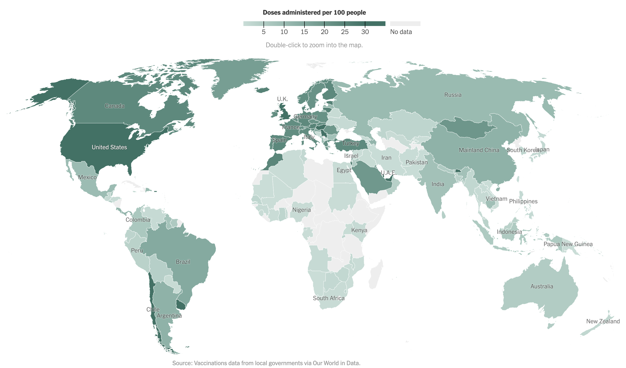
PROJECT SCOPE
Scope Description:
Analyze and identify which significant factors affect Covid-19 vaccination rate in different countries to help find relationship between variables and visualize them
Objectives:
Understand current vaccination progress and compare and interpret results for the client to better predict further vaccination progress in different countries
Project Deliverables:
Conduct market research; use descriptive analytics; develop predictive analytics; interpret results into business and public health insights
Notes:
Assima

Slide 6
02.
MARKET RESEARCH
Notes:
Adam

Slide 7
Issue Tree
Main Study Question Sub Questions Components of Sub Questions Analysis To Be Performed
How accessible is the Covid -19 vaccine
Which demographic factors affect the vaccination progress?
Does the region and GDP per capita affect the vaccination?
Does age and population take a role in the distribution?
What factors determine which vaccine countries use?
Did countries invest in the vaccine they are using?
How does vaccine efficacy affect the implementation of it?
Conduct an ANOVA analysis between various regions and countries
Build a predictive model and descriptive visualization
Conduct distribution analysis
Run correlation analysis between vaccines efficacy and vaccines adoption rate
Notes:
Adam

Slide 8
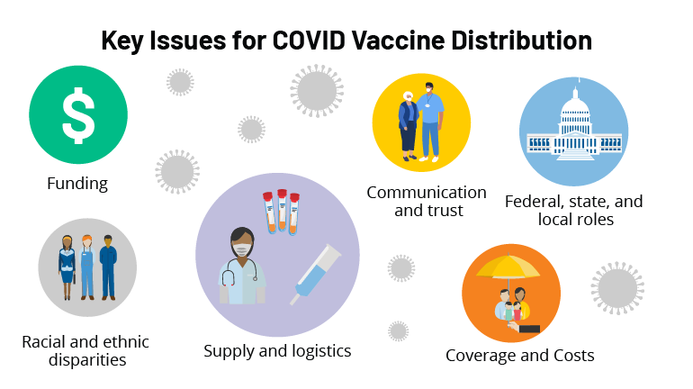
What factors determine which vaccine countries use?
Politics and international relations
Efficacy and medical agency approval (skepticism)
Vaccine prices – Sputnik V is cheaper than most Western alternatives, and is also easier to store
Accessibility – poorer nations struggle to access Western shots like Pfizer, Moderna; some nations purchase a combination of different vaccines as they become available
Distributing a COVID-19 Vaccine Across the U.S. - A Look at Key Issues
https://www.kff.org/report-section/distributing-a-covid-19-vaccine-across-the-u-s-a-look-at-key-issues-issue-brief/
Notes:
Assima

Slide 9
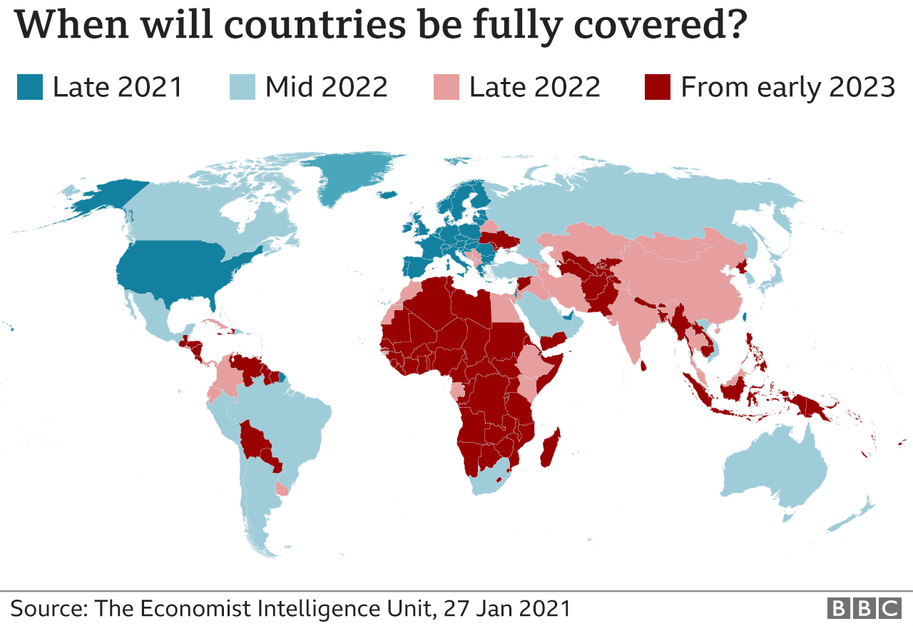
Did countries invest in the vaccine they are using?
Rich vs Poor
The UK and the US invested a lot into vaccine development and put themselves at the front of the queue
Other rich countries
Canada and EU are a little further behind
Canada bought x5 the supply it needs, but it was not positioned for priority delivery
Invest in vaccines from European factories
Anticipated export ban threats from the US under Donald Trump
Reality: European factories are struggling with supply and recently it has been the EU, not the US, that has been threatening export bans
Notes:
Assima

Slide 10

Effects of Vaccine Pricing
Pfizer and Moderna have strong Positive correlation with Strong GDP per cap
Pfizer for one dose is $19.50 in the U.S.A and $14.76 in the EU
Moderna for one dose is $15 in the U.S.A and $18 in the EU
Covaxin and AstraZeneca has a strong correlation with total vaccinations
AstraZeneca is extremely cheaper than its competitors at only $2.15 per dose
Which allows countries to distribute more shots at a lower cost
However alongside lower costs come lower efficacy rates
The number of people vaccinated has a strong correlation to health expenditure
The strong correlation between people vaccinated and health expenditure is due to the availability of a large amount of government funds to buy and distribute vaccines doses effectively
Notes:
Adam

Slide 11
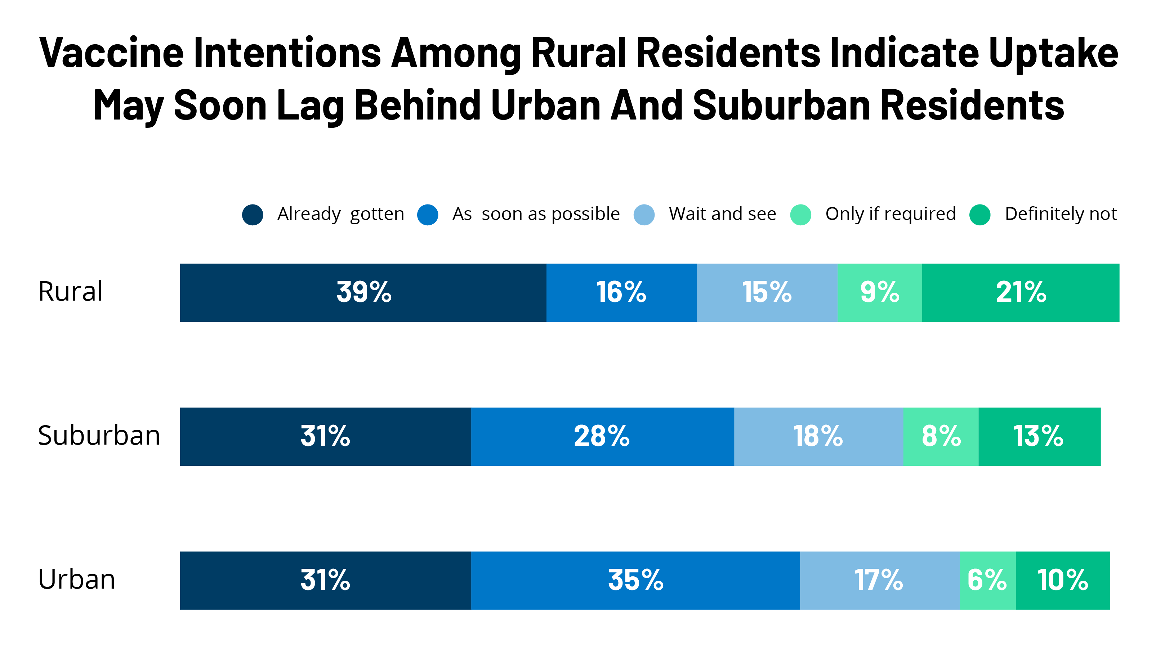
Urban & Rural Population
Currently more than half of rural residents have already received or plan to receive their COVID-19 vaccine
Majority of the urban population has found receiving the vaccine is greater than those located in rural areas
Majority of the divide in the urban & rural population in getting vaccinated is due to different age groups in almost every state
https://www.kff.org/coronavirus-covid-19/poll-finding/vaccine-hesitancy-in-rural-america/
Notes:
Adam

Slide 12
03.
DATA ANALYSIS
Notes:
Assima

Slide 13
About The Data & Methods
114
Countries
7
Vaccines
5
GDP Brackets
2
Quantitative Variables
7
Binary Variables
Notes:
Tay

Slide 14

Notable Variables
CO2_Emissions, Individuals with access to Internet
- Indirectly identifies of a country's technological development
Healthcare Expenditures, Urban Population
- Indirectly identifies with a country’s economic complexity
- Altered efficiency and complexity of vaccination efforts
Population over 60s / Population below 14
- Identified the economic strength or weakness of a country
J&J Vaccine
- Released shortly before creation of dataset
- Insufficient data to build accurate models using vaccine currently
Notes:
Justin

Slide 15
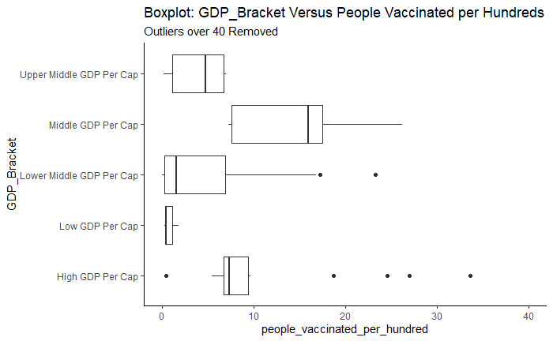
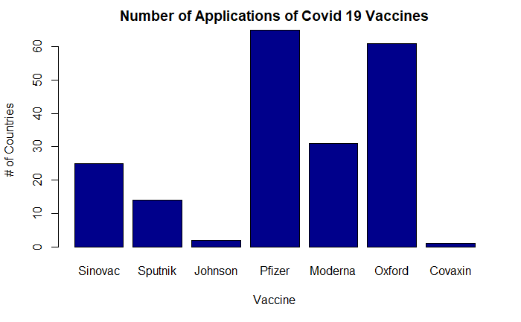
Descriptive Analytics
Chi Square Test (GDP Brackets)
X-squared = 50.757, df = 4, p-value = 2.509e-10
Significant difference between countries by brackets
T Test (GDP Per Capita vs Pfizer Adoption)
t = -6.5761, df = 71.159, p-value = 6.909e-09
Significant differences in GDP between countries that adopted Pfizer
ANOVA (People Vaccinated ~ GDP Per Capita + CO2_Emmissions)
No significant difference found between economic development variables
Possibility open for modeling using factors
Notes:
Justin

Slide 16
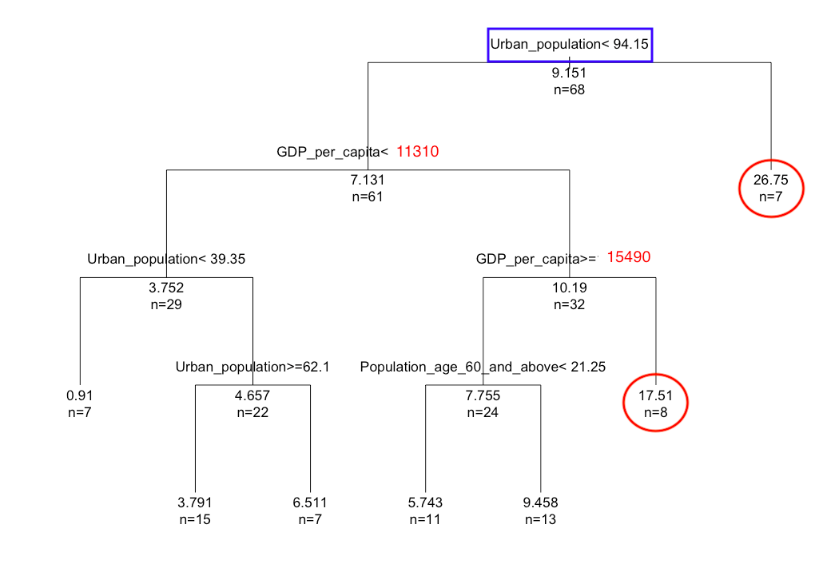
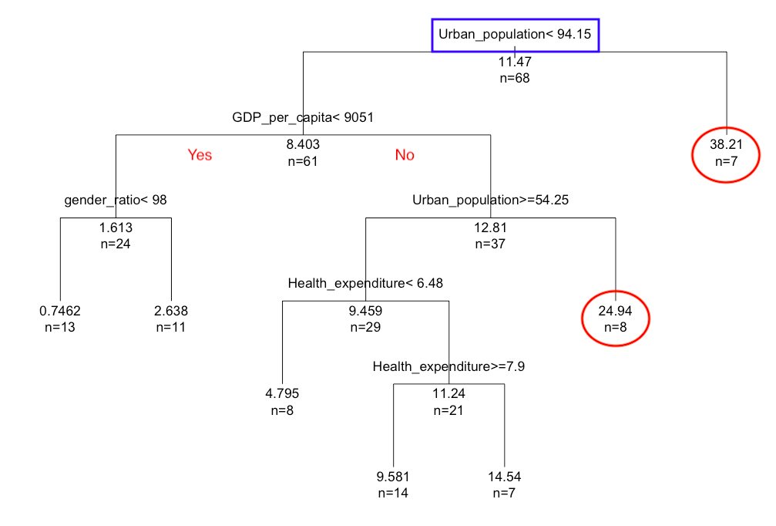
Regression Tree with Standardization
People_vaccinated_per_hundred:
Total_vaccinations_per_hundred:
Yes
No
Notes:
Tay

Slide 17

Multivariate Linear Regression
People Vaccinated (with interaction)= population*GDP_per_capita + CO2_emission
Significant Variables: Population, GDP_Per_Cap:Population
R^2: 0.8812
Adjusted R^2: 0.8726
P Value: 2.2e-16
Analyzes efficiency of a country’s vaccination efforts
Majorities of countries do not have developed economies or healthcare system
Allows model to work effectively with underdeveloped or developing countries
Underpredicts developed countries
Notes:
Ari
People vaccinated is focused on the progress of a country’s vaccination effort
Interaction effect means that two or more variables combined have a significantly larger effect on a feature as compared to the sum of the individual variables alone
Population and GDP per cap was found to have a strong correlation as the research showed stronger economies able to afford more vaccines for populace
CO2 emissions shows complexity of economy, tying with the research on how developed countries have an edge with its vaccination progress
Models work well for most countries as they do not have complex healthcare systems explaining why the model has a high A – R value
Useful to client to provide insight on how vaccination would progress in various countries around the globe as they start their full scale vaccination efforts
Model predicts a minimum value given input factors

Slide 18
Predicted People Vaccinated
 | Population (in thousands) | GDP Per Capita | CO2 Emission (Tons) | People Vaccinated (Predicted) | Ratio
CHINA | 1,409,517 | 8109.1 | 101,394 | 53,745,857 | 3.8%
MEXICO | 129,163 | 8980.9 | 8,514 | 5,052,404 | 3.9%
THAILAND | 69,038 | 5814.8 | 3,338 | 1,982,795 | 2.7%
Notes:
Ari

Slide 19
Key Findings (Vaccination Efforts)
CO2_Emissions, Healthcare Expenditures, Population over 60s, Urban Population indicators for economic development
Countries’ vaccination efforts differ depending on complexity of economy and healthcare system
Majority of countries have simpler economies and healthcare systems allowing for more accurate predictions
Certain Geo Political factors explains percentage of false positives and false negatives in model
Some countries are tied by treaty or trade agreement
Countries that invested in vaccine development get prioritization
Notes:
Ari

Slide 20
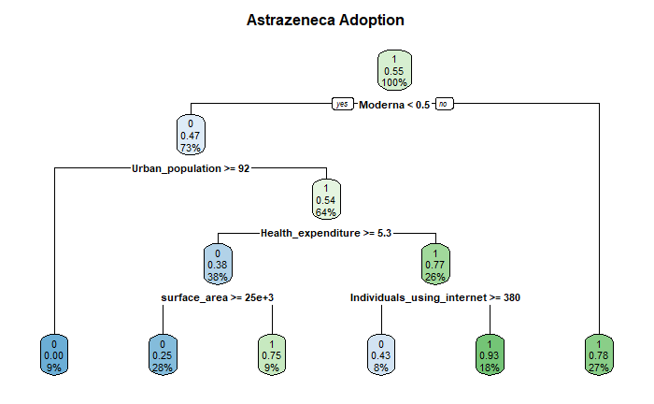
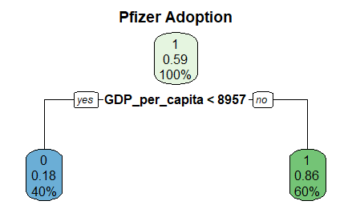
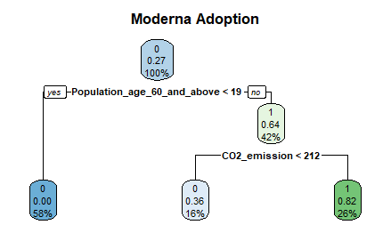
Vaccine Classification Model
Goal to determine what attributes of a country dictate if they would adopt a certain type of vaccine
 | Predicted Usage
Actual Usage |  | 0 | 1
 | 0 | 10 | 6
 | 1 | 8 | 5
 | Predicted Usage
Actual Usage |  | 0 | 1
 | 0 | 10 | 5
 | 1 | 2 | 12
 | Predicted Usage
Actual Usage |  | 0 | 1
 | 0 | 21 | 1
 | 1 | 5 | 2
Notes:
Justin

Slide 21

Key Findings (Vaccines Implementation)
Pfizer and Moderna used only by rich countries with highly developed economies
Causes higher total vaccination due to double dose
Has best public perception but highest infrastructure cost
Countries using these vaccines had higher GDP_Per_Capita
J&J and AstraZeneca standing as best widely accessible vaccine
J&J and AstraZeneca adopted by countries that could not afford Pfizer or Moderna
Relatively new and not reflected in dataset
Significant external adoption and public perception issues
SinoVac/SinoPharm, Sputnik, and Covaxin used by less developed countries
Model noted that countries preferred western vaccines
Countries using these vaccines had higher younger population and CO2_Emissions
Notes:
Justin

Slide 22
04.
CONCLUSION
Notes:
Assima

Slide 23

Business Insights
Regression Models to be used by client to predict how vaccination efforts will proceed
Classification models to be used to determine which vaccine is a good fit for a country
Strength and intricacies of governments’ infrastructure, healthcare systems, and technology are major factors in vaccinations progress
Less developed nations likely to have slower progress due to lack of supply of vaccines
Countries with larger urban and older populations need to be prioritized
Notes:
Assima

Slide 24

Recommendations
Focus on countries with large dense populations to achieve high impact on Covid 19 vaccination progress
Determine which vaccines would be a good economical and logistical fit for target country
Further research needed on AstraZeneca and J&J vaccines
Conduct further research onto the impact of political ties with vaccination efforts
Notes:
Assima

Slide 25
THANK YOU
Notes:
Assima

Slide 26
Work Cited
Hegarty, Stephanie. “Covid Vaccine Tracker: How's My Country and the Rest of the World Doing?” BBC News, BBC, 12 Feb. 2021, www.bbc.com/news/world-56025355. ​
​
Steenhuysen, Julie, et al. “Special Report: Countries, Companies Risk Billions in Race for Coronavirus Vaccine.” Reuters, Thomson Reuters, 25 Apr. 2020, www.reuters.com/article/us-health-coronavirus-vaccine-specialrep/special-report-countries-companies-risk-billions-in-race-for-coronavirus-vaccine-idUSKCN2270U1. ​
​
Litvinova, Daria. “Sputnik V Vaccine Was Met with Skepticism; Now Russia Struggles to Make Enough.” The Times of Israel, 9 Mar. 2021, www.timesofisrael.com/demand-for-russian-sputnik-v-virus-vaccine-is-spiking-but-supply-snags/.
Centers for Disease Control and Prevention. (2021, February 4). Demographic Characteristics of Persons Vaccinated During the First Month of the COVID-19 Vaccination Program - United States, December 14, 2020–January 14, 2021. Centers for Disease Control and Prevention. https://www.cdc.gov/mmwr/volumes/70/wr/mm7005e1.htm.
Hua, S. (2021, April 10). China's Covid-19 Vaccination Campaign Gets Off to Slow Start. The Wall Street Journal. https://www.wsj.com/articles/china-knocks-on-peoples-doors-to-speed-up-domestic-covid-19-vaccination-11618069774.
Nambi Ndugga Follow @nambinjn on Twitter, O. P. (2021, May 26). Latest Data on COVID-19 Vaccinations Race/Ethnicity. KFF. https://www.kff.org/coronavirus-covid-19/issue-brief/latest-data-on-covid-19-vaccinations-race-ethnicity/.
​

